Slide 1
Forklift Operation Qualifications
Qualifications/classification | Skill training course graduates | Special training graduates | Notes
Maximum load of 1 ton or more | ○ | - | Does not include driving forklifts on public roads
Maximum load of under 1 ton | ○ | ○

Slide 2
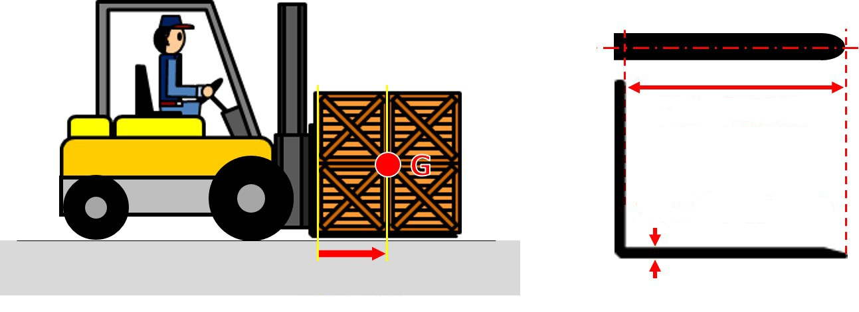
Load Center and Fork length
Fork length
Maximum fork thickness
Load center

Slide 3
Standard Load Center
Standard load center D
Rated load Q
^{a)}: Includes the distance of 1220 and 1250.

Slide 4
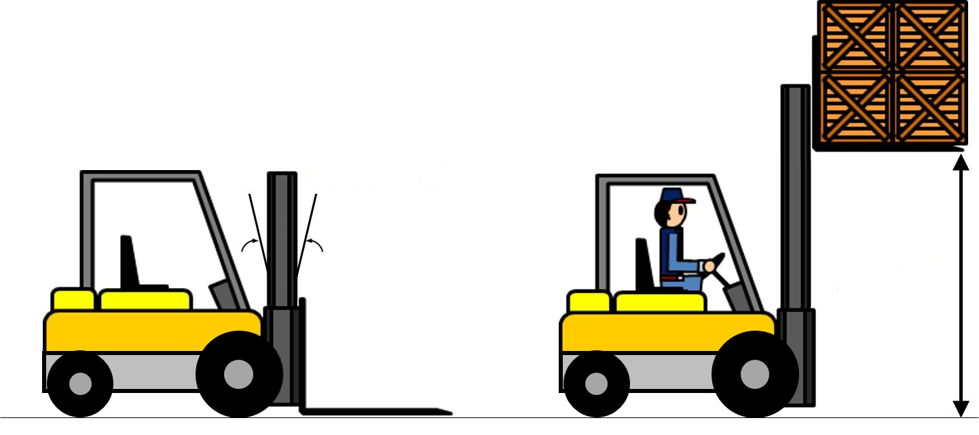
Mast Tilt Angle and Maximum Lifting Height
Mast tilt angle
Maximum lifting height

Slide 5
Maximum Load and Allowable Load
The allowable load that can be loaded at the standard load center is called “Maximum load”.
(specified load)
The load on the load curve is called “Allowable load”.
Load
Standard load center
(a load center)

Slide 6
Terms Related to Load, Performance, and Status
Maximum lifting height for 3,000 and 4,000 mm mast
Maximum lifting height for 4,500 mm mast
Maximum lifting height for 5,000 mm mast
Allowable load (kg)
Load center (mm)

Slide 7
A Comparison of Diesel Engines and Gasoline Engines
 | Diesel engine | Gasoline engine
Fuel types | Diesel fuel (fuel oil) | Gasoline
Ignition or lighting | Ignited by the heat of compressed air | Lit by an electric spark
Mass per output | Heavy | Light
Cost per output | High | Low
Thermal efficiency | Good (30 - 40%) | Bad (20 - 26%)
Operating costs | Low | High
Fire safety | High | Low
Noise/vibration | High | Low
Startup during winter | Slightly bad | Good

Slide 8
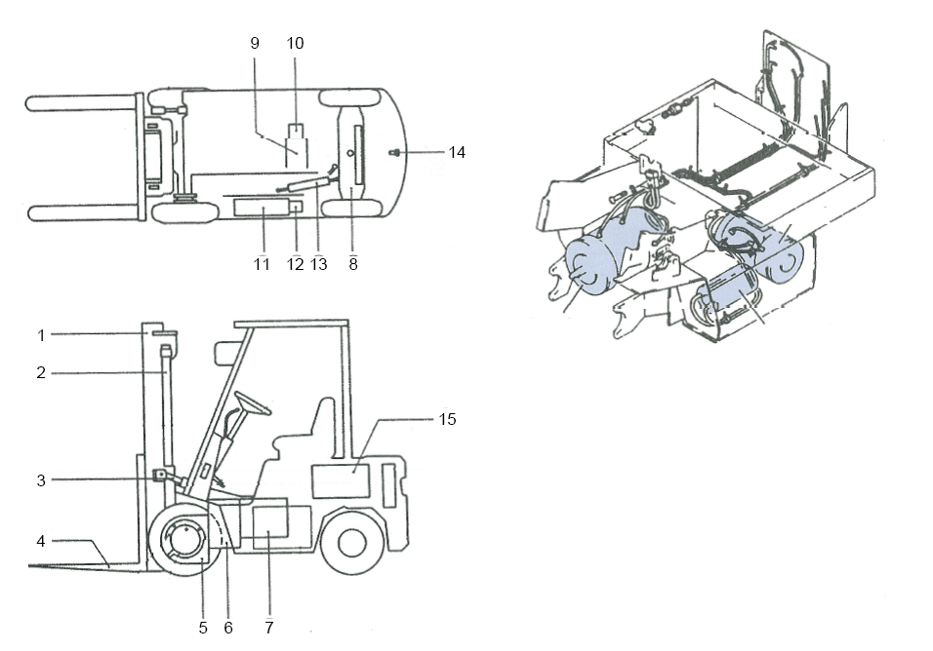
Components of a Battery-Powered Counterbalance Forklift
Pump motor
Drive motor
Power steering motor
1 | Mast | 9 | Electric motor for loading/unloading
2 | Lift cylinder | 10 | Hydraulic pump for loading/unloading
3 | Tilt cylinder | 11 | Electric motor for steering
4 | Fork | 12 | Hydraulic pump for steering
5 | Differential | 13 | Hydraulic cylinder for steering
6 | Reduction gear | 14 | Counter weight
7 | Electric motor for traveling | 15 | Battery
8 | Rear axle

Slide 9
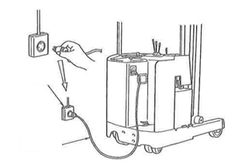
Charging with an On-Board Battery Charger
Power
Charging cord

Slide 10
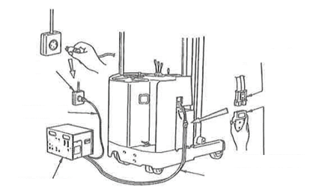
Charging with a Stationary Battery Charger
Battery plug
Power
Charging cord
Output cord plug
Stationary battery charger
Output cord

Slide 11
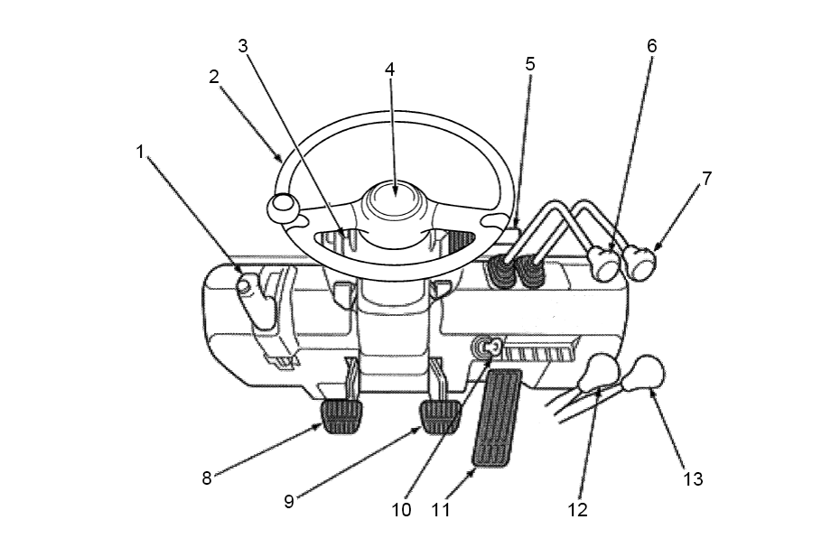
Clutch Vehicle
1 | Parking brake lever
2 | Steering wheel
3 | Combination meter
4 | Horn switch
5 | Direction indicator/light switch
6 | Lift lever
7 | Tilt lever
8 | Clutch pedal
9 | Brake pedal
10 | Starting switch
11 | Accelerator pedal
12 | High speed/low speed lever
13 | Forward/reverse lever

Slide 12
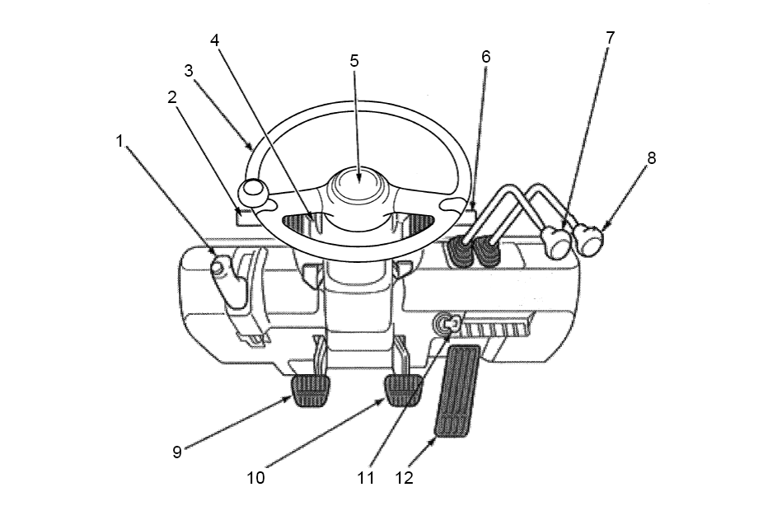
Torque Converter Vehicle
1 | Parking brake lever
2 | Forward/reverse lever
3 | Steering wheel
4 | Combination meter
5 | Horn switch
6 | Direction indicator/light switch
7 | Lift lever
8 | Tilt lever
9 | Inching pedal
10 | Brake pedal
11 | Starting switch
12 | Accelerator pedal

Slide 13
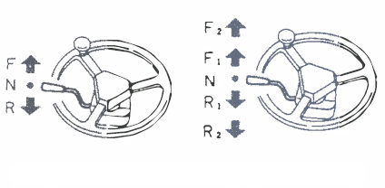
Torque Converter Vehicle Acceleration/Deceleration Operations
[1-speed torque converter vehicle]
[2-speed torque converter vehicle]

Slide 14
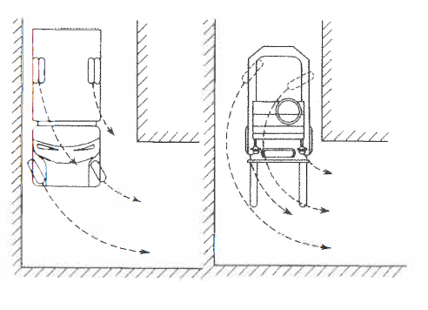
Cornering Differences
Regular automobile
Forklift

Slide 15
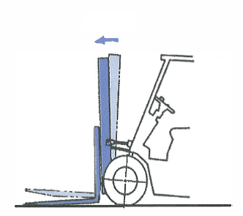
Tilting the Mast Forward
Tilt forward

Slide 16
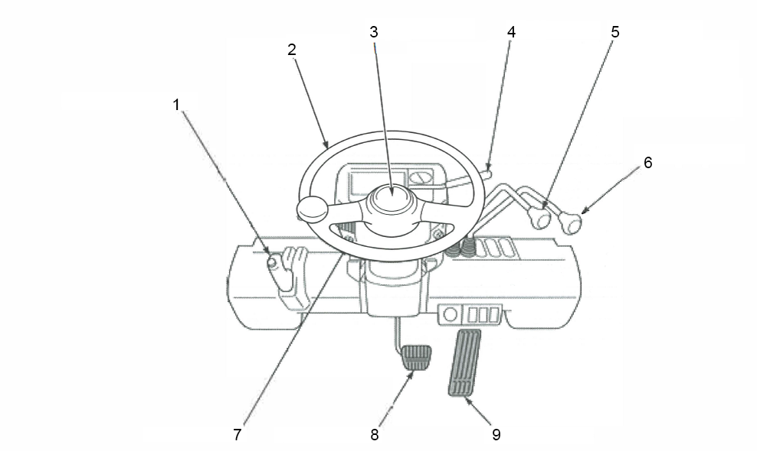
Battery-Powered Counterbalance Forklift Operator’s Seat
1 | Parking brake lever
2 | Steering wheel
3 | Horn switch display
4 | Forward/reverse lever
5 | Lift lever
6 | Tilt lever
7 | Light switch
8 | Brake pedal
9 | Accelerator pedal

Slide 17
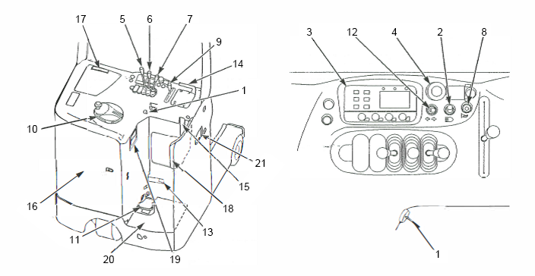
Stand-Up Reach Forklift Operator’s Seat
1 | Starting switch
2 | Light switch
3 | Meter panel (Battery capacity display, hour meter, malfunction code display, adjustment mode display)
4 | Emergency power cut button
5 | Lift lever
6 | Tilt lever
7 | Reach lever
8 | Horn
9 | Accelerator lever
10 | Steering wheel
11 | Brake pedal
12 | Turn signal switch
13 | Battery lock pedal
14 | Assist grip
15 | Hydraulic fluid level gauge
16 | Back door
17 | Note folder
18 | Back support
19 | Charging panel
20 | Floor plate (Interlock plate)
21 | Battery plug

Slide 18
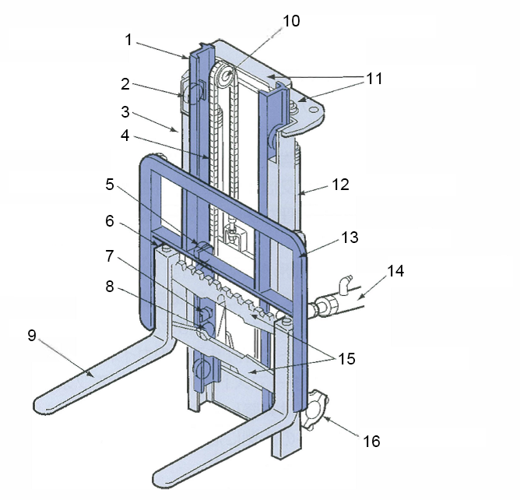
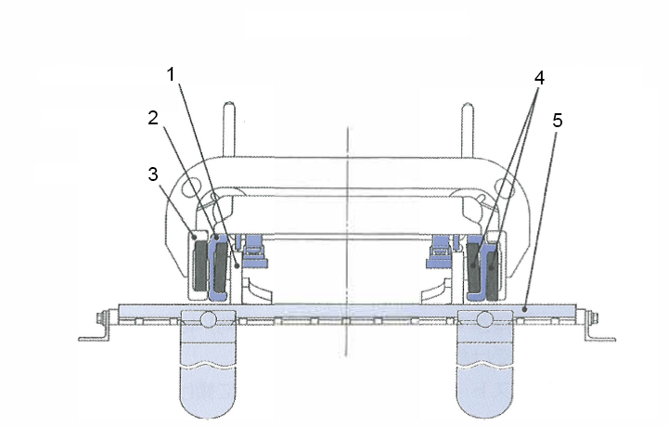
Loading/Unloading Device Part Names
1 | Inner mast
2 | Lift roller
3 | Outer mast
4 | Lift chain
5 | Lift roller
6 | Fork stopper
7 | Side roller
8 | Lift roller
9 | Fork
10 | Chain wheel
11 | Crossbeam
12 | Lift cylinder
13 | Backrest
14 | Tilt cylinder
15 | Finger bar
16 | Mast support
From above the fork
1 | Lift bracket
2 | Inner mast
3 | Outer mast
4 | Lift roller
5 | Finger bar

Slide 19
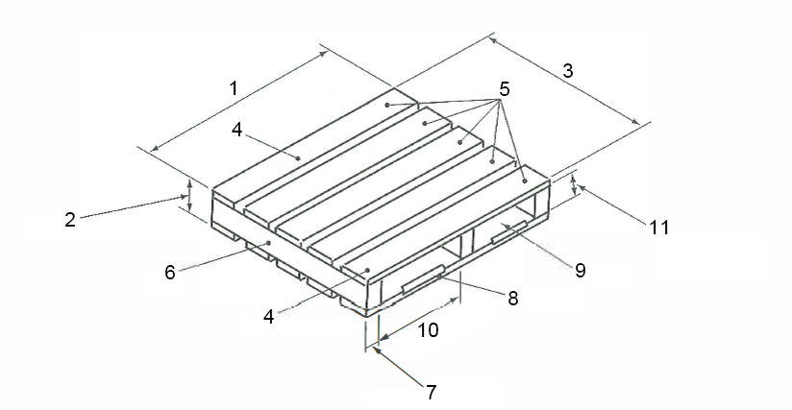
Flat Pallet Part Names
1 | Pallet width
2 | Pallet height
3 | Pallet length
4 | Edge board
5 | Deck board
6 | Stringer
7 | Stringer width
8 | Chamfer
9 | Inserting opening
10 | Inserting opening width
11 | Inserting opening height (stringer width)

Slide 20
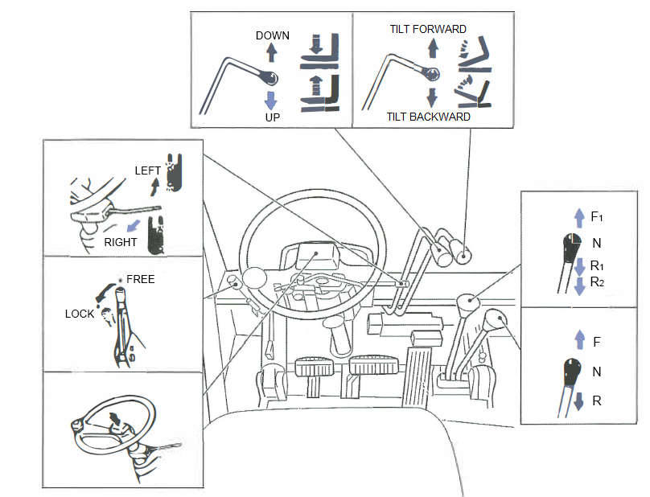
Lever Operation (Ex.)
Lift lever
Tilt lever
Turn signal switch
Shift lever
Parking brake lever
Forward/reverse lever
Horn button

Slide 21
No Riding

Slide 22
No Driving with a Load Lifted

Slide 23
Periodic Self-Inspection

Slide 24
Operation under Overwork and Drinking

Slide 25
Work in the Proper Safety Wear
Helmet
Chin strap
Protective footwear

Slide 26
Initial Inspection
Wait until the initial inspection is completed!

Slide 27
Embarking/Disembarking the Vehicle

Slide 28
Lower the Fork When Driving

Slide 29
Drive Forward Uphill and in Reverse Downhill

Slide 30
Repair Problems Immediately

Slide 31
Do Not Load Oversized Loads

Slide 32
Never Stand under a Fork

Slide 33
Never Lift a Person with the Fork

Slide 34
Never Suspend Items from a Fork

Slide 35
Charge in a Well-Ventilated Place

Slide 36
Open the Battery Cover during Charging

Slide 37
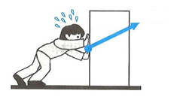
Three Elements of Force
Magnitude
Direction
Acting point

Slide 38
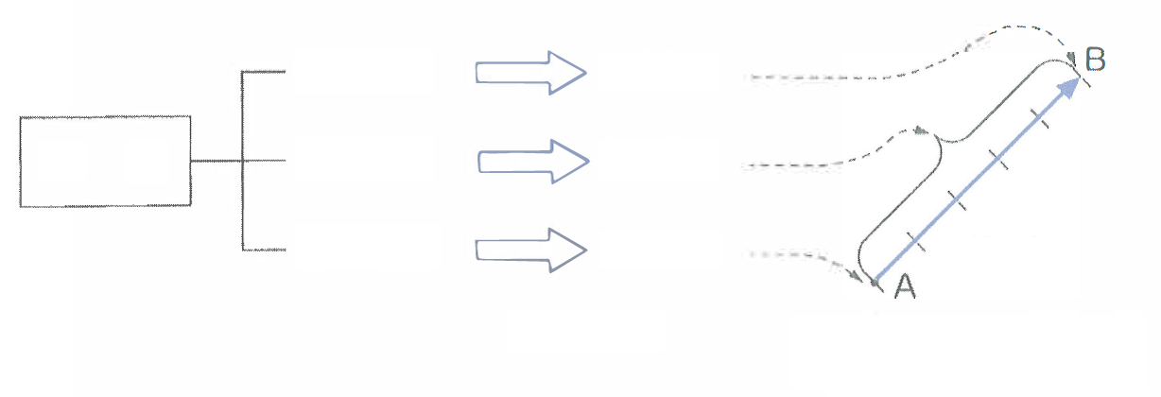
Vectors
Direction
Direction of the arrow
Force
Magnitude
Length of the arrow
Force line of action
Acting point
Base of the arrow
Three elements of force
Vectors
(Ex. 1 N = 1 cm)

Slide 39
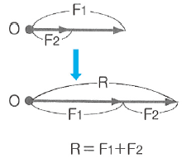
Composition of Two Forces

Slide 40
Parallelogram Law of Forces

Slide 41
Decomposition of Forces (1)
Component force Fa
Resultant force (R)
(Reaction force of F)
Component force Fb

Slide 42
Decomposition of Forces (2)

Slide 43
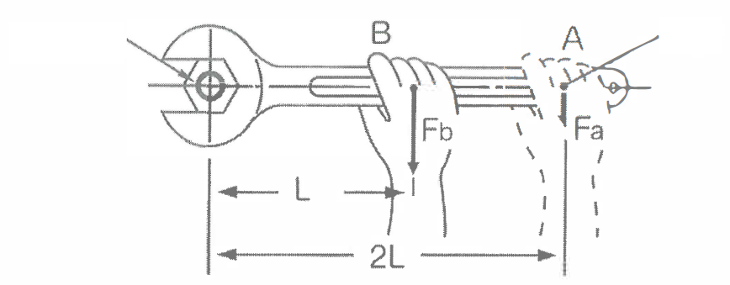
Tightening Force and Moment
Axis of rotation O
Force point

Slide 44
Balance of Forces on a Single Point
Acting point
Mass

Slide 45
Balance of Forces on a Single Point
Mass

Slide 46
Balance of Parallel Forces

Slide 47
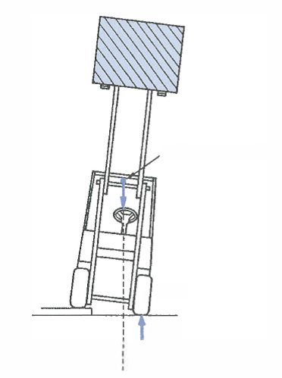
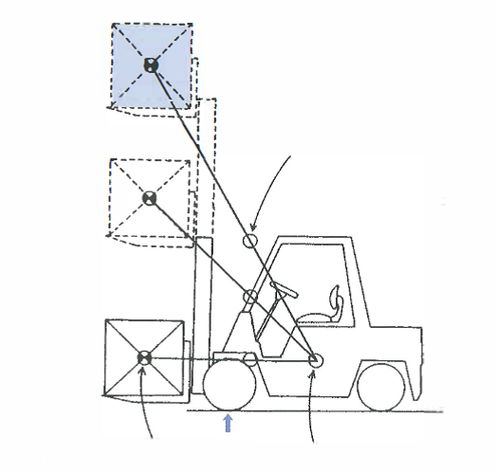
Movement of Overall Center of Gravity
The Dangers of Tipping on Uneven Surfaces
Overall center of gravity (G)
Overall center of gravity (G)
Front wheel
Load’s center of gravity (G1)
Fulcrum
Body’s center of gravity (G2)
Fulcrum

Slide 48
COG Position of Forklift
When COG is not Balanced
Acceleration
Turns sharply
Front wheel
Frame
Rear wheel
Rear axle
Center pin
Vehicle is stable when COG is at G2, however, it may tip over when COG is at G1 or G3.

Slide 49
Forklift Inertial Force

Slide 50
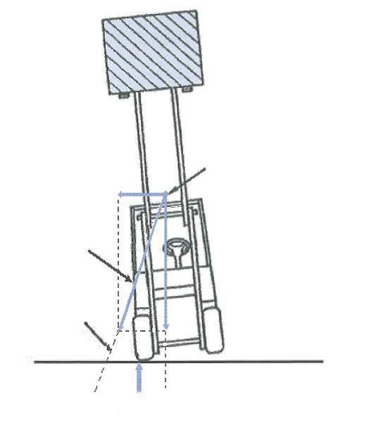
Tipping due to Centrifugal Force
Overall center of gravity
Centrifugal force
Resultant force
The vehicle tips if the line of action of the resultant force of the overall mass and centrifugal force lies outside the tire (fulcrum).
Line of action
Fulcrum

