Slide 1
Qualifications of Crane Operator
Lifting load and type of operation |  | 5 tons or more |  |  |  | Less than 5 tons
 |  | Crane (including wireless) | Floor operated crane | Floor operated crane (moves along with load) | Telpher
Certification types | Crane/derrick operator’s license (no limitations) | ○ | ○ | ○ | ○ | ○
 | Floor operated crane operator’s license (limited) |  | ○ | ○ | ○ | ○
 | Skill training course for floor operated crane |  | ○ | ○ | ○ | ○
 | Special education for crane operation |  | ○ |  | ○ | ○

Slide 2
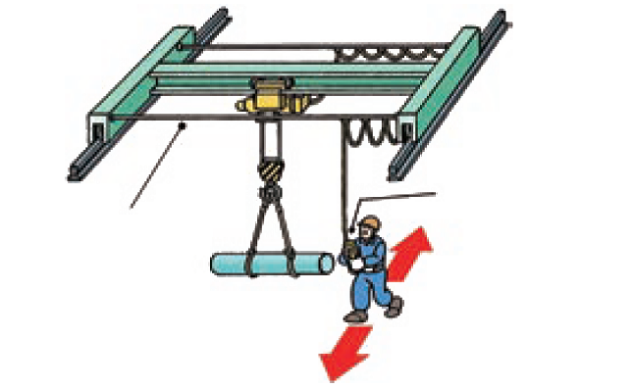
Pendant Switch Suspended from Messenger Wire
Pendant switch
Messenger wire
The operator has to move with the lifted load while traveling.

Slide 3
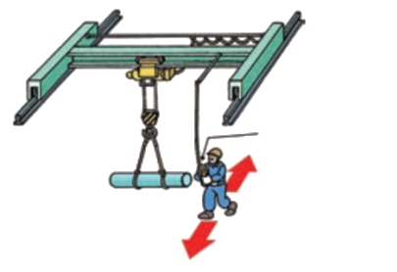
Pendant Switch Suspended from Fixed Place of Girder
Pendant switch
The operator has to move with the lifted load while traveling.

Slide 4
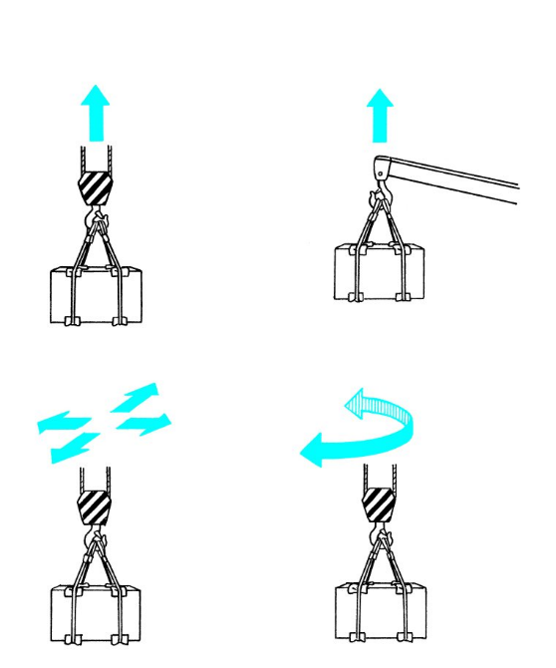
Definition of Cranes
Lift the loads by power
Carry the lifted loads horizontally

Slide 5
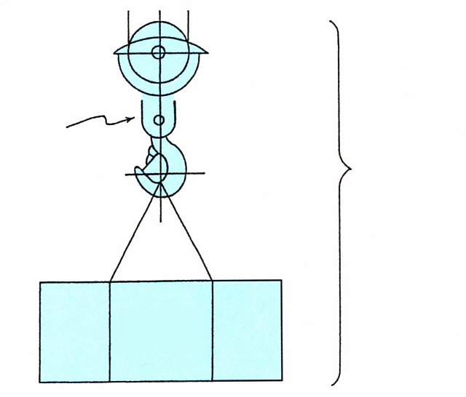
Lifting load, Rated load
Hoisting accessory
Lifting load
Rated load

Slide 6
Rated Load
Load can be lifted
Weight of hoisting accessory
Lifting load
Rated load
Operating radius

Slide 7
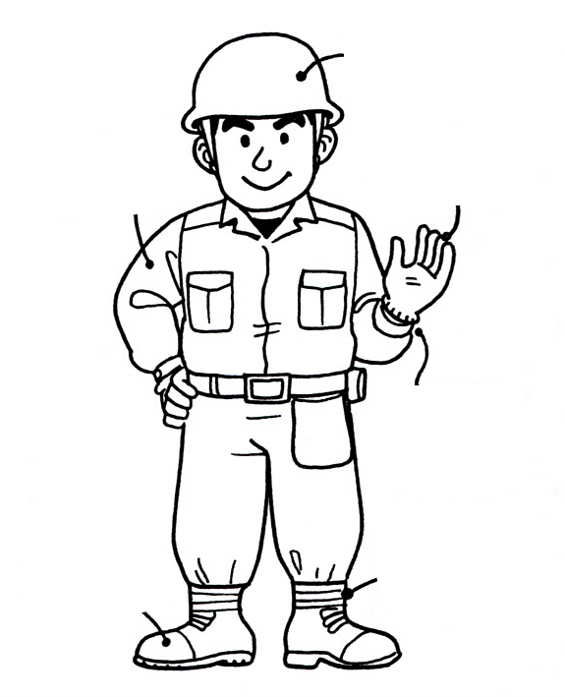
Working Outfit
Hard hat
Wear a long-sleeved jacket
Working gloves
Keep the cuff buttons fastened.
Fasten your pant cuffs.
Safety shoes

Slide 8
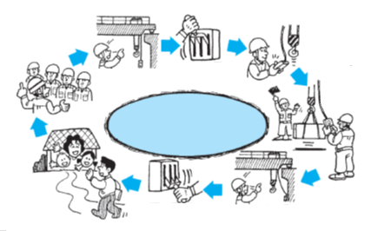
Daily Work Flow
Prestart inspection
Turning on the power
Prestart inspection
Prestart meeting
(confirmation of crane motions)
(static inspection)
Safe operation
Daily Work Flow of Floor-operated Crane
Turning off the power
Inspection after completed the work

Slide 9
Prestart Inspection
Brake performance
Rail condition
Prestart inspection
Over-winding preventive device
Traversing
Traveling
Lifting and Lowering
Confirmation of the path for hoisting wire ropes and chains
Confirmation of the push button switch
Hook safety catch device

Slide 10
Inspect How the Crane Operates
Whether the crane works as directed
Check!

Slide 11
Winding Status of the Drum
a: Appropriate condition
b: Inappropriate condition (random winding)

Slide 12
Prohibition of Overload

Slide 13
Keeping the Safety Device Effective (1)
Over-winding preventive limit switch does not work.

Slide 14
Keeping the Safety Device Effective (2)
Some worker secures the hook with tapes
Unbelievable !!

Slide 15
No Collision to the Stopper

Slide 16
Prohibited Operations
Stop operation in the following cases.
1. | Unclear signals
2. | Signals from two or more signalers
3. | Sling by unqualified workers
 | Signal from other than a designated signaler
4. | Dangerous slinging
5. | Over rated load
6. | When workers may get caught in the load

Slide 17
Transportation of Workers by Cranes is Prohibited
Do not use the crane to transport or lift a worker.

Slide 18
Leaving with a Load Lifted is Prohibited
Do not leave the operating position with the load lifted!

Slide 19
Measures When an Abnormality is Found
Failure
Malfunction
Maintenance supervisor

Slide 20
Traction by a Guide Rope
Do not pull the guide rope!

Slide 21
Danger of Two-Way Simultaneous Operation
Traveling direction
Operating route
Moving direction of the load
Traversing direction

Slide 22
Standing by with a Load Lifted
Do not stop the crane with the load lifted above a safety walkway or job site.
Wait for a signal
Job site
Safety walkway

Slide 23
Prohibition of Opposite Operation
Opposite operation

Slide 24
Startup During the Inspection is Prohibited

Slide 25
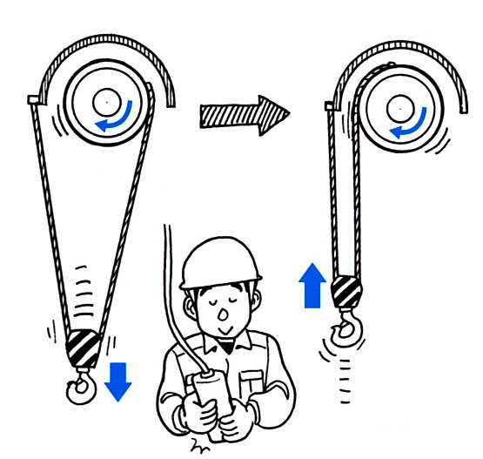
Reverse Winding of Wire Rope for Lifting
For club trolleys without lowering limit switch, if lowering operations continue, the hoisting wire rope is wound up in the reverse direction.
Normal
Reverse winding

Slide 26
Acquiring Qualifications for the Slingers
Those who have completed the slinging skill training course
Safe!

Slide 27
Sling Angle
Preferably within 60 degrees
(90 degrees in maximum)

Slide 28
Take Enough Distance to Evacuate
Take enough distance from the swinging load.

Slide 29
Pulling the Load Sideways and Lifting It Obliquely are Prohibited

Slide 30
Rapid Lifting of the Load is Prohibited
Stop lifting once when the sling wire ropes are taut.

Slide 31
Checking the Rope Condition
Noosing of a sling wire rope
Guide rope
Load collapse

Slide 32
Checking the Unloading Place

Slide 33
Pulling Out the Sling Wire Ropes by the Crane Is Prohibited
Never pull out the sling wire ropes from under the load by the hoist motion of the crane.

Slide 34
Lifting the Swinging Hook is Prohibited
Hoist drum
Random winding

Slide 35
Handling the Pendant Switch
Do not release the pendant switch while pulling it up.

Slide 36
Hook Position
The COG is off!
The load will swing!

Slide 37
Anti-swing Operation
Anti-swing operation

Slide 38
Routine Checkup
Problem!
Failure symptom

Slide 39
Stopping When Abnormal
Turn off the power supply switch.

Slide 40
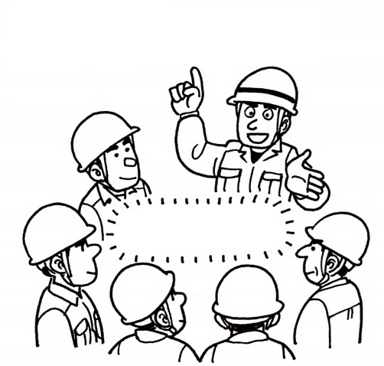
Prearrangements
Prearrangements for Inspection
Prearrangements

Slide 41
Checking the Weather Information
Strong winds are expected according to weather information

Slide 42
Stop Operation due to Rain
It’s starting to rain, let's stop.

Slide 43
Danger due to Electric Shock
Duration of current flow
Body current
Notes
AC-1: Perception possible but usually no ‘startled’ reaction.
AC-2: Perception and involuntary muscular contractions likely but usually no harmful electrical physiological effects.
AC-3: Strong involuntary muscular contractions. Difficulty in breathing. Reversible disturbances of heart function. Usually no organic damage to be expected.
AC-4: Patho-physiological effects may occur such as cardiac arrest, breathing arrest, and burns or other cellular damage.
Probability of ventricular fibrillation increasing with current magnitude and time.
AC-4.1: Probability of ventricular fibrillation up to about 5 %.
AC-4.2: Probability of ventricular fibrillation up to about 50 %
AC-4.3: Probability of ventricular fibrillation is over 50 %.

Slide 44
Relationship between Magnitude and Arm of Force

Slide 45
Moment of Leverage
Fulcrum

Slide 46
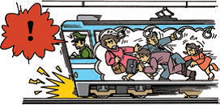
Inertia

Slide 47
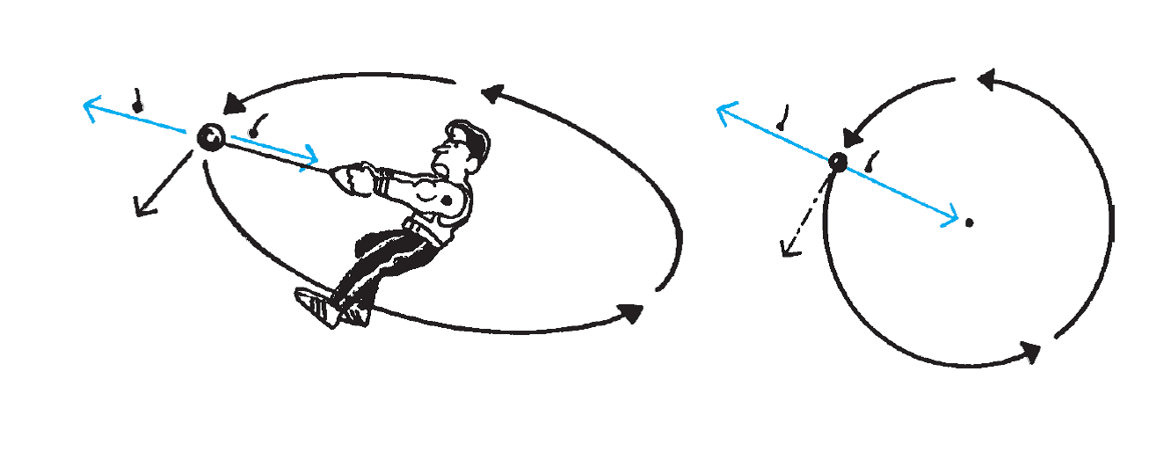
Centripetal and Centrifugal Forces
Centrifugal force
Centrifugal force
Centripetal force
Centripetal force
Center
Tangential direction
Tangential direction

Slide 48
Outward Movement of Lifted Load and Changes in Operating Radius due to Centrifugal Force
Operating radius before slewing
Operating radius during slewing

Slide 49
Movable Pulley

Slide 50
Tension of Sling Wire Ropes
m: Weight of the load (t)
Fw: 9.8 × m (kN)
F₁, F₂: Tension of the sling wire rope (kN)
F: Resultant force (kN)
F = Fw
P: Force pulling the sling wire ropes inward (kN)
Sling angle
Sling wire rope

